Slide 1
Guide BP Deep Dream, Deep Art and Fooling Convolutional Neural Networks
Deep Learning

Slide 2
Guide BP Deep Dream, Deep Art and Fooling Convolutional Neural Networks
VII SEM-C2&C3/Deep Learning/2024-25
Activity: One-minute paper
Dt: 24-10-24

Slide 3
Guided BP
ReLU is an activation function that deactivates the negative neurons.
We are only interested in knowing what image features the neuron detects.
So when propagating the gradient, we set all the negative gradients to 0. We don’t care if a pixel “suppresses’’ (negative value) a neuron somewhere along the part to our neuron.
Value in the filter map greater than zero signifies the pixel importance, which is overlapped with the input image to show which pixel from the input image contributed the most.

Slide 4
Guided BP-The Idea
Consider any one neuron in feature map at any layer
we actually are interested to find influence of the input on this neuron
Then retain this neuron and set all other neurons in the layer to zero.
Then BP
In fwd pass: ReLU processes on;y +ve values, all –ve values will be made to set zero.
NOTE: so, when gradients flow back, the same , ReLU makes –ve values to zero
( if ReLU neuron ia dead, gradient doesn’t flow back)
IDEA: both, fwd and bckwd pass: don’t allow –ve vales, instead maked them zero.

Slide 5
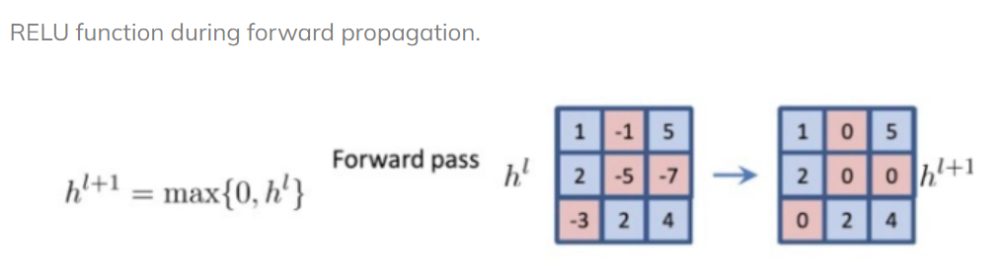
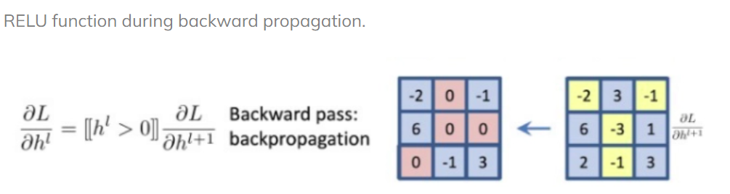
Guide BP

Slide 6
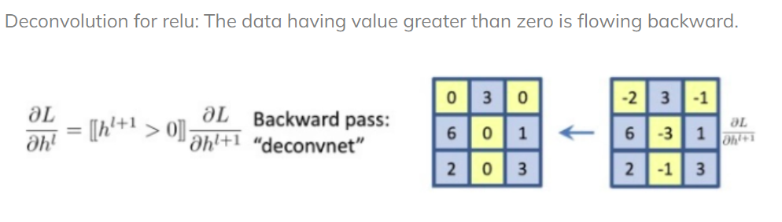
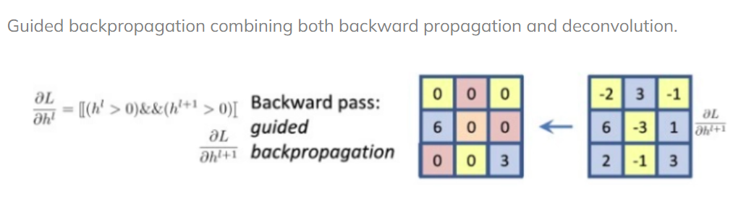
Guided BP

Slide 7
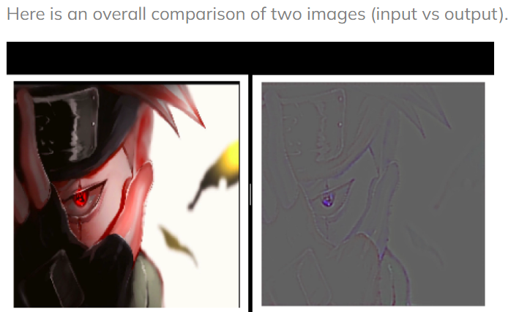

Slide 8
Deep Dream
A machine dreams or hallucinates by mimicking low-level visual systems of the human brain, in order to perceive patterns and categorise objects.
The machine begins to produce outputs even in the absence of any inputs.
The outputs are not just meaningless patterns of neurons, but depend on previous learning that the network undergoes representing data “attractors” — where some random neurons start to fire,
the weighted connections representing real output rapidly come to dominate the overall pattern of activity in the network, resulting in the pattern corresponding to a particular input.

Slide 9
Deep dream
think about it like staring at clouds and seeing patterns or images, a phenomenon known as pareidolia
DeepDream does the same thing by enhancing patterns it sees in a given image based on what it has been trained to see in the past.
So, if a network has been trained to recognize faces in images, then if we give it images of clouds it will try and extract faces from the clouds via algorithmic pareidolia.

Slide 10
Deep Dream
"Deep dream" is an image-filtering technique which consists of taking an image classification model, and running gradient ascent over an input image to try to maximize the activations of specific layers (and sometimes, specific units in specific layers) for this input. It produces hallucination-like visuals.
It was first introduced by Alexander Mordvintsev from Google in July 2015.

Slide 11
Deep Dream
Process:
Load the original image.
Define a number of processing scales ("octaves"), from smallest to largest.
Resize the original image to the smallest scale.
For every scale, starting with the smallest (i.e. current one): - Run gradient ascent - Upscale image to the next scale - Reinject the detail that was lost at upscaling time
Stop when we are back to the original size.
To obtain the detail lost during upscaling, we simply take the original image, shrink it down, upscale it, and compare the result to the (resized) original image.

Slide 12

Deep Dream

Slide 13
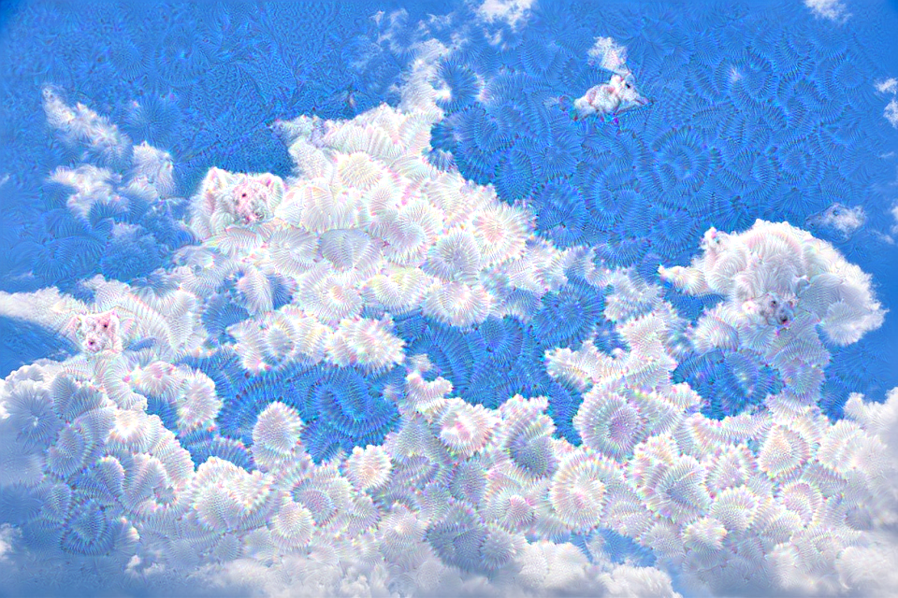
Deep Dream-the pareidolia output
NOTE: You can use the trained model hosted on Hugging Face Hub and try the demo on Hugging Face Spaces.

Slide 14
Deep Art
DeepArt is based on deep learning — multi-layer neural networks which are supposed to mimic human brain.
uses a pre-trained neural network for detecting geometric shapes in the image. The algorithm extracts the geometric shapes from the images and applies texture from the ‘style’ image, typically a painting by an artist, to the content image provided by the user.
It basically takes a photo that you upload and redraws it in the style of another photo you upload or a style among the famous paintings shown on the website.
This application was created by Łukasz Kidziński & Michał Warchoł based on a paper: Leon A. Gatys, Alexander S. Ecker, and Matthias Bethge in the research paper entitled ‘A neural algorithm of artistic style’.

Slide 15
Fooling CNN
Suppose we feed an image to the Convent, and we know this is the bus image. Now, instead of setting the cross-entropy loss to maximise bus.
Try setting up cross-entropy loss to maximise ostrich, and the backpropagate to the network.
We will not modify any of these weights for parameters but only change the Image.
We know this is a bus image, but now setting the objective to fire for the Ostrich class.
So we will backpropagate and change this Image to increase the likelihood of ostrich class.
And it turns out that if we do it with very minimal changes to the Image, we can fool the convolutional neural network.

Slide 16
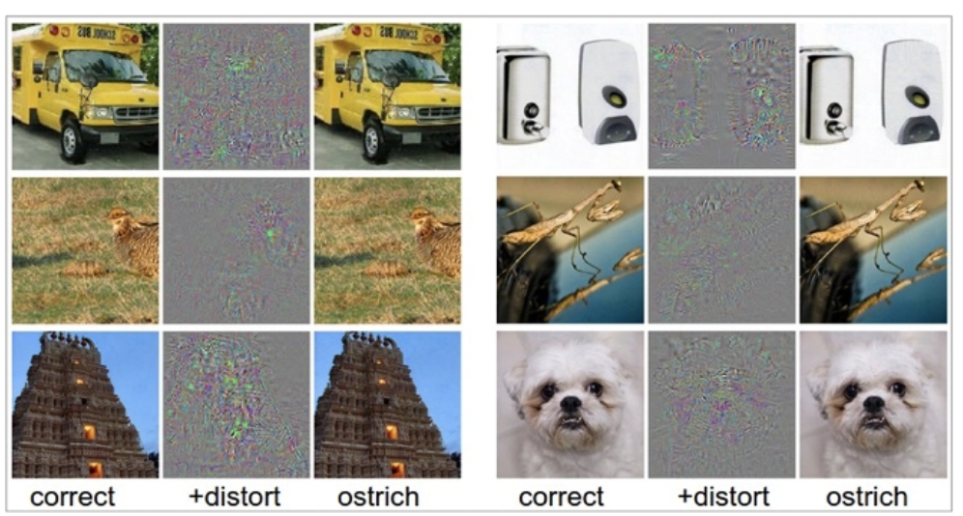
Fooling CNN

Slide 17
Fooling CNN
The probability of realistic images is very, very small. Most of these are random things; they are just matrices that do not make any sense, which look like the images you see here.
Images are incredibly high-dimensional objects. These are 227 x 227 metrics which is a very high dimensional object.
And no matter how much training data we have, we see only a tiny space of this high dimensional Image because it's a real number 227x227. Just imagine the number of possibilities out there.
Whether we have 1 million samples or 10 million samples for training, this is much smaller than the number of models in the space. Of these, only a few are images.
So now think of all 227 x227 metrics that you can make and how many of them will be natural images. The probability of realistic images is very, very small. Most of these are random things; they are just matrices that do not make any sense, which look like the images you see here.

